Slide 1
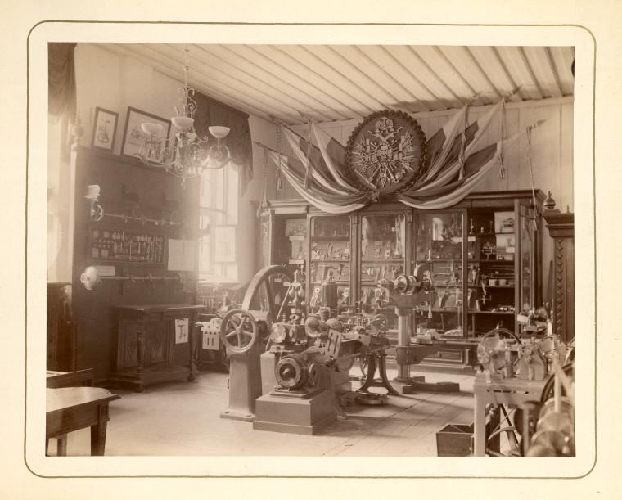
Some tools that come to mind
A five-in-five talk by Leonard Richardson
@leonardr
Links at the end

Slide 2
GitLab
When you want to keep something under version control
  But you don't want the whole world to see it
    But you're okay with having it on someone else's server
      And you're cheap
Or when you don't want to contribute to the GitHub monoculture

Slide 3
PDFMiner
Extract text blocks from PDF
Keep track of where on the page the text was found
Supposedly can extract images, but I haven't been able to get it to work
Python library with command-line interface
See also: Tabula (haven't used it)

Slide 4
Corpora
Lists of things in JSON format
Cities, household objects, stopwords, dinosaurs, Crayola colors, beers, Pokemon, fabrics, occupations, toxic chemicals, knots, wrestlers, words with no rhyming word, TV shows, body parts, etc.

Slide 5
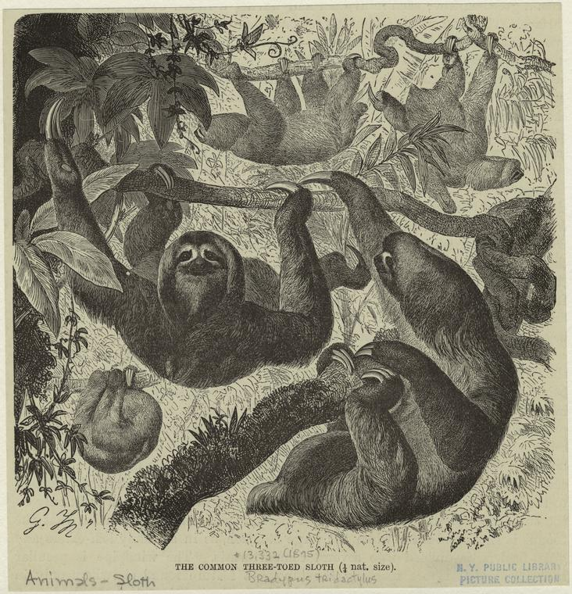
NYPL Digital Collections API
Find freely usable pictures of anything (that existed before 1923)

Slide 6
@LinkRelations
Twitter bot you can follow to be notified about new IANA-registered link relations
Started in March 2014
One update since (derivedfrom)

Slide 7
The promised links
GitLab: http://gitlab.com/
PDFMiner: https://euske.github.io/pdfminer/
Tabula: http://tabula.technology/
Corpora: https://github.com/dariusk/corpora/
NYPL Digital Collections API: http://api.repo.nypl.org/
@LinkRelations

